Slide 1
Operating Systems
计算机科学与技术学院
高海昌
hchgao@xidian.edu.cn

Slide 2
Contents
  1. Introduction **
  2. Processes and Threads ******
  3. Deadlocks **
  4. Memory Management *****
  5. Input/Output ***
  6. File Systems ****
  8. Multiple Processor Systems **
  9. Security **
  10. Case study – Linux *

Slide 3
Chapter 8: Multiple Processor Systems
  8.1 Multiprocessors
  8.2 Multicomputers
  8.3 Virtualization
  8.4 Distributed systems

Slide 4
Multiprocessor Systems
The computer industry has been driven by an endless quest for more and more computing power.
One approach to greater speed is through massively parallel computers. Highly parallel computers are often used for heavy number crunching.
Another relevant development is the incredibly rapid growth of the Internet.

Slide 5
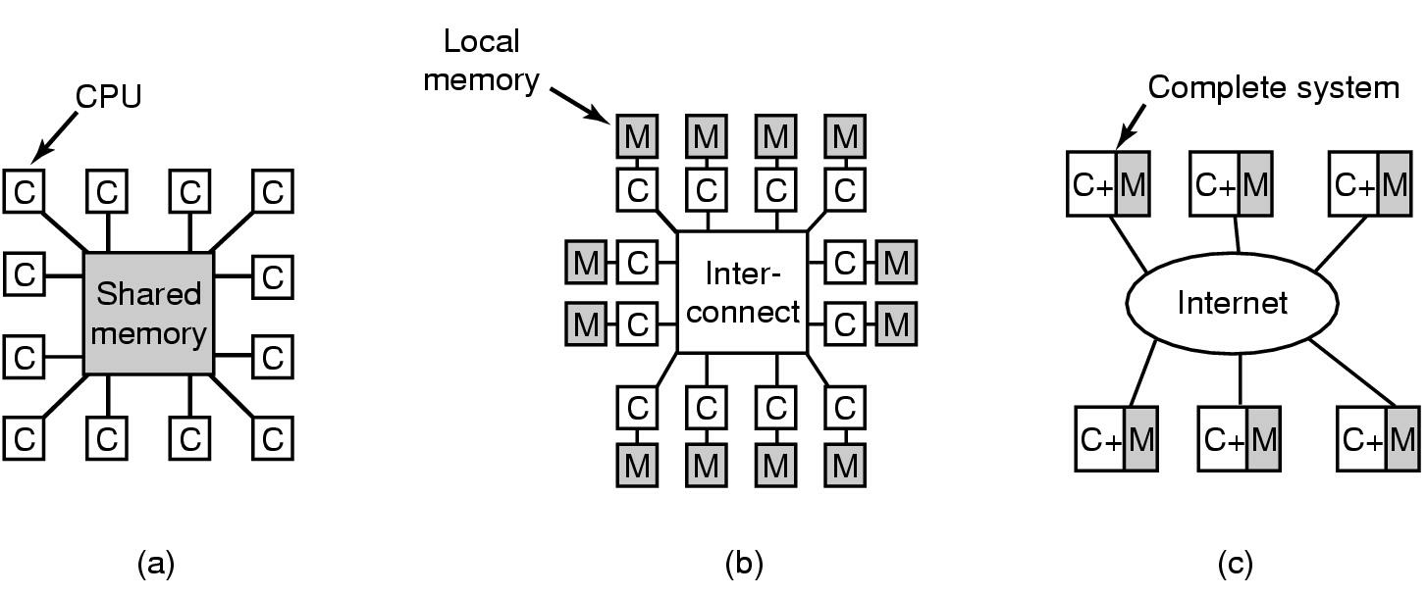
Multiprocessor Systems
Continuous need for faster computers
  share memory model
  message passing multi computer (tight-coupled)
  wide area distributed system (loose-coupled)

Slide 6
Multiprocessors
Share-memory multiprocessor:
A computer system in which two or more CPUs share full access to a common RAM
    every CPU has equal access to the entire physical memory
    can read and write individual words using LOAD and STORE instructions
    data speed: 10-50nsec

Slide 7
Multiprocessors
UMA ( Uniform Memory Access，统一内存访问 )
  每个存储器字的读出速度是一样快的。
    UMA Multiprocessors with Bus-Based Architectures
    UMA Multiprocessor Using Crossbar Switches（交叉开关）
    UMA Multiprocessor Using Multistage Switching Networks（多级交换网络）
NUMA ( Nonuniform Memory Access，非统一内存访问 )

Slide 8
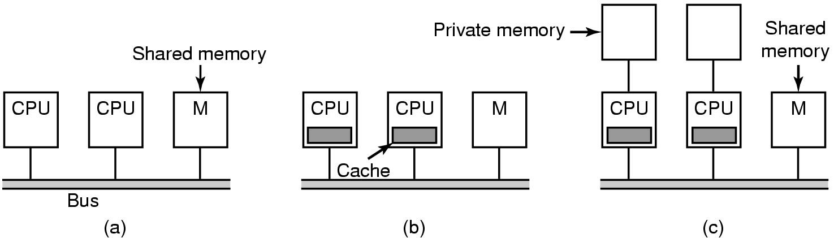
Multiprocessor Hardware (1)
Bus-based multiprocessors
(a) Without caching
(b) With caching
(c) With caching and private memories
Notes:
总线结构把处理机的数量限制在了16至32个CPU。

Slide 9
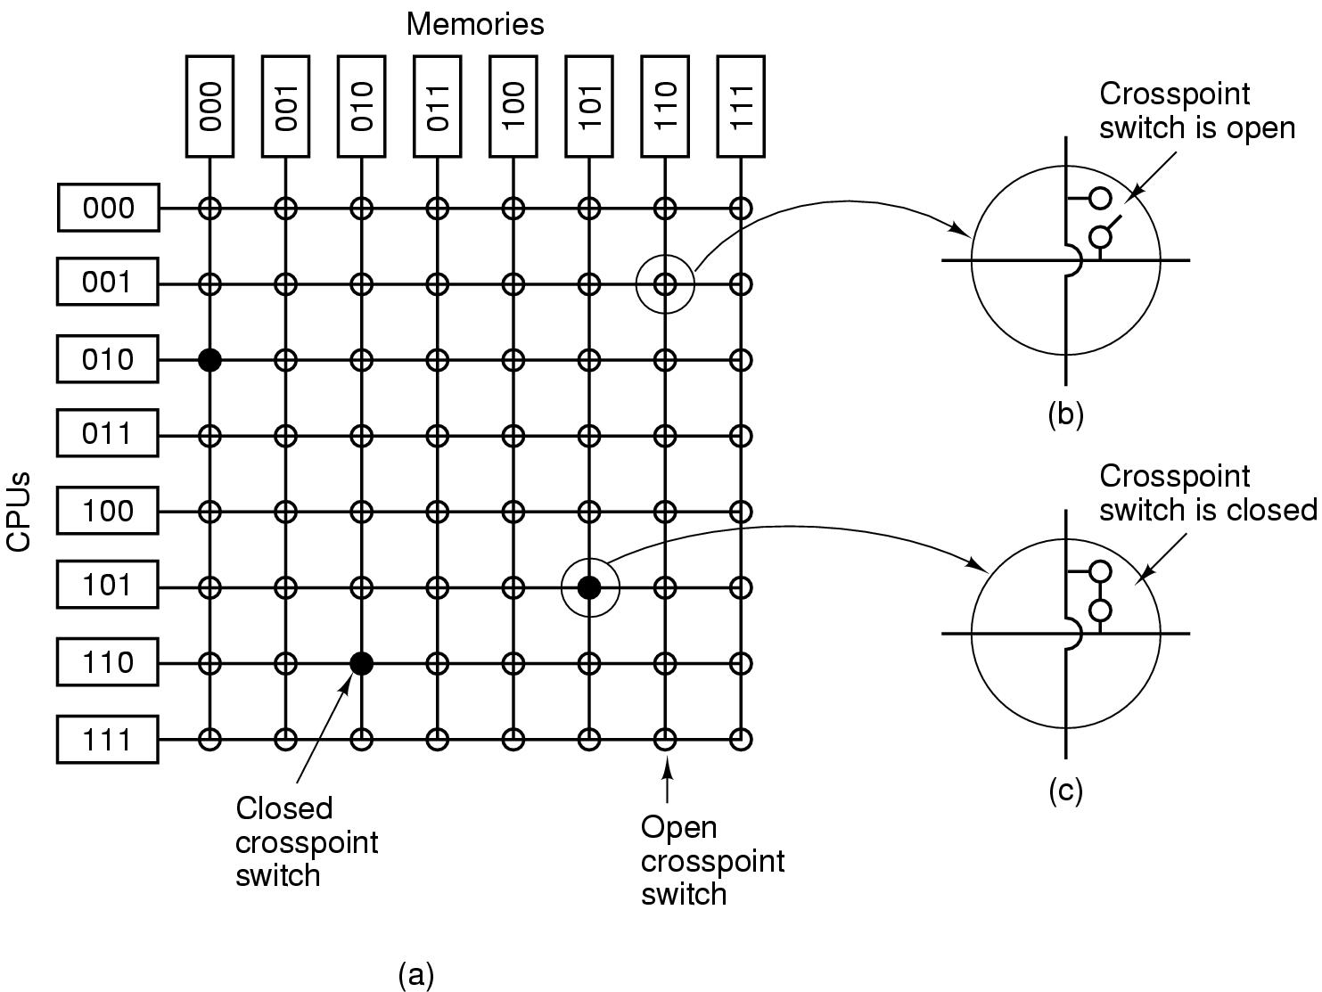
Multiprocessor Hardware (2)
UMA Multiprocessor using a crossbar switch

Slide 10
Multiprocessor Hardware (2)
UMA Multiprocessor using a crossbar switch
  Ad: It is a nonblocking network。
  Disad: the number of crosspoints grows as n²

Slide 11
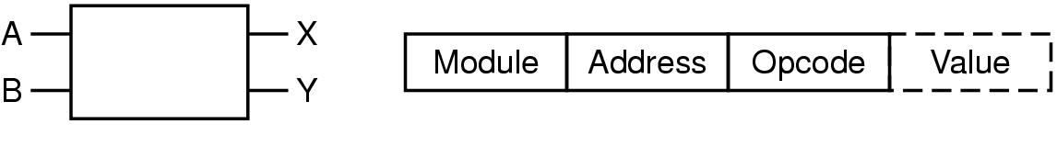
Multiprocessor Hardware (3)
UMA multiprocessors using multistage switching networks can be built from 2x2 switches
(a) 2x2 switch (b) Message format
  Module：使用哪个存储器
  Address：在模块中的地址
  Opcode：操作
  Value：操作数

Slide 12
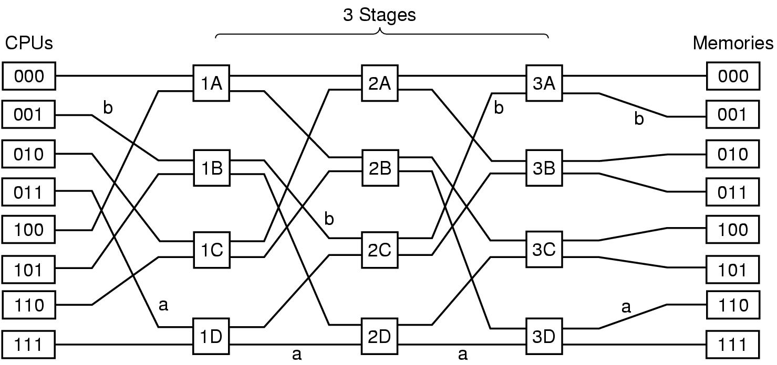
Multiprocessor Hardware (4)
Omega Switching Network

Slide 13
Multiprocessor Hardware (5)
NUMA Multiprocessor Characteristics
  Single address space visible to all CPUs
  Access to remote memory via commands LOAD and STORE
  Access to remote memory slower than to local memory

Slide 14
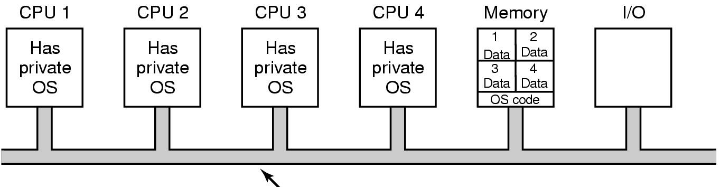
Multiprocessor OS Types (1)
Bus
Each CPU has its own operating system
  Statically divide memory into n parts.
  Give each CPU its own private memory and its own private copy of the OS.
  Each OS has its own table, no sharing of processes; no sharing of pages; inconsistent buffer cache.

Slide 15
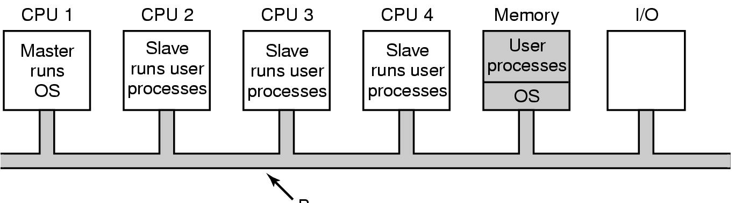
Multiprocessor OS Types (2)
Bus
Master-Slave multiprocessors
  One copy of the OS and its table is present on CPU1.
  All system calls are redirected to CPU1 for processing.
  Dis: With many CPUs, the master will become a bottleneck.

Slide 16
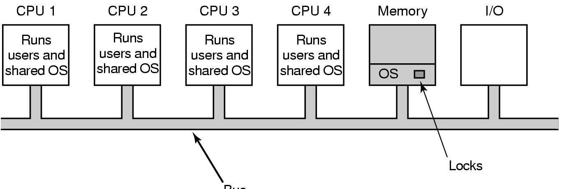
Multiprocessor OS Types (3)
Bus
Symmetric Multiprocessors
  There is one copy of the OS in memory, but any CPU can run it.
  Associate a mutex (i.e., lock) with the OS, making the whole system one big critical region.

Slide 17
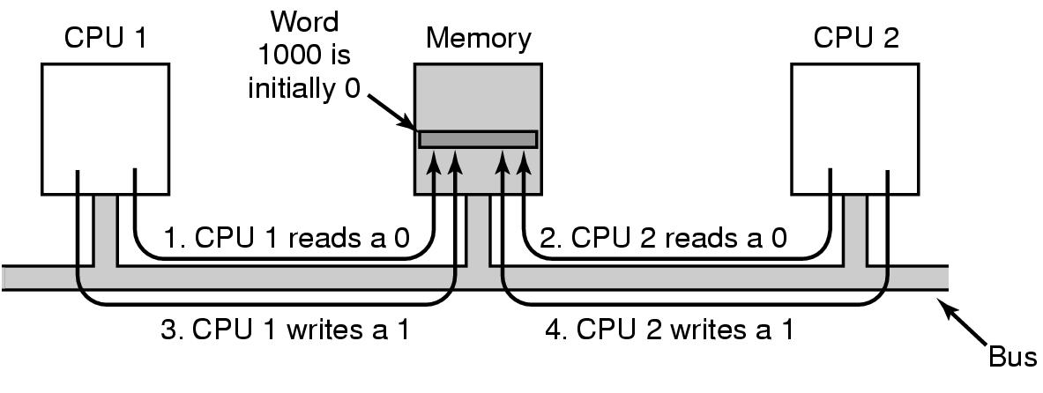
Multiprocessor Synchronization (1)
TSL instruction can fail if the bus cannot be locked
To prevent this problem, the TSL instruction must first lock the bus, preventing other CPUs from accessing it, then do both memory accesses, then unblock the bus.

Slide 18
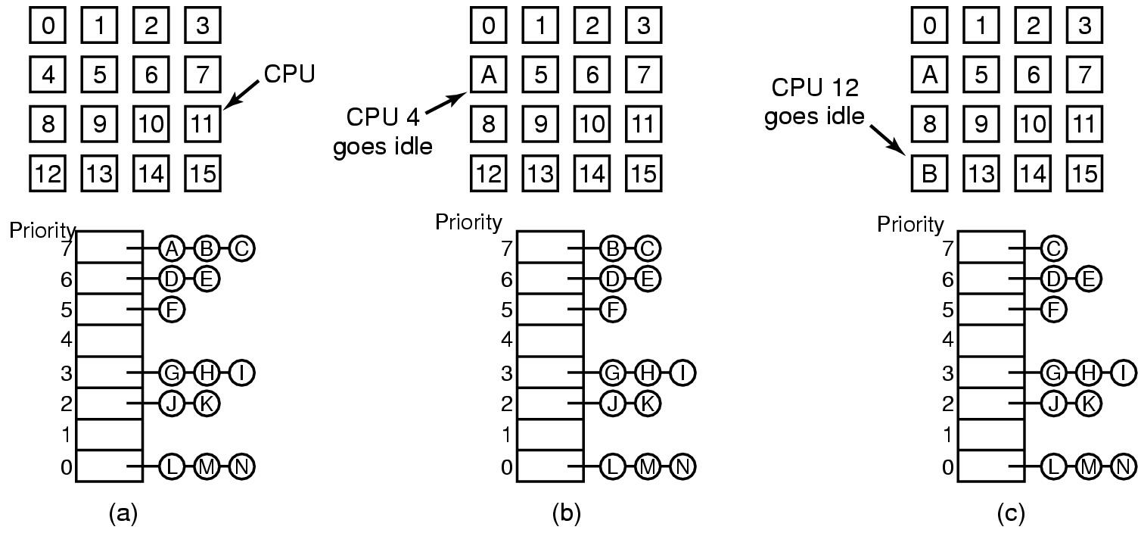
Multiprocessor Scheduling (1)
Timesharing
  Using a single data structure for scheduling a multiprocessor

Slide 19
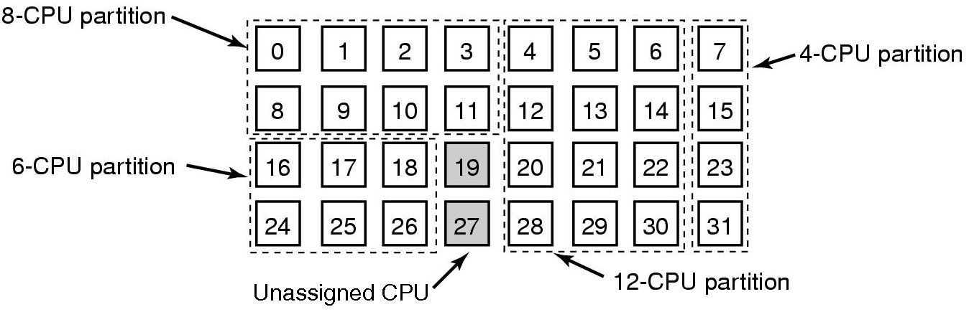
Multiprocessor Scheduling (2)
Space sharing
  multiple threads at same time across multiple CPUs

Slide 20
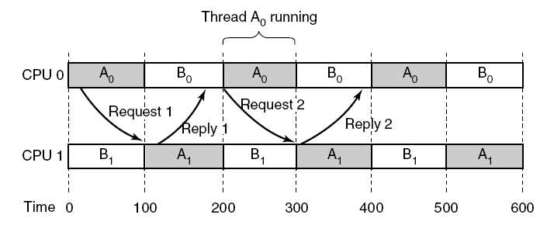
Multiprocessor Scheduling (3)
Communication between two threads belonging to thread A that are running out of phase.
P547 Fig8-14
Notes:
空间共享消除了多道程序设计

Slide 21
Multiprocessor Scheduling (4)
Gang Scheduling（群调度）
  Groups of related threads scheduled as a unit (a gang)
  All members of gang run simultaneously（同时） on different timeshared CPUs
  All gang members start and end time slices together

Slide 22
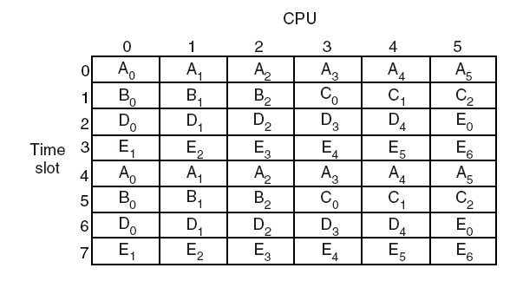
Multiprocessor Scheduling (5)
Gang Scheduling

Slide 23
Chapter 8: Multiple Processor Systems
  8.1 Multiprocessors
  8.2 Multicomputers
  8.3 Virtualization
  8.4 Distributed systems

Slide 24
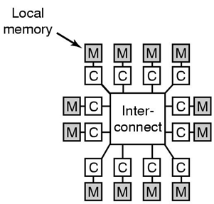
Multicomputers
Message-passing multicomputer:
Tightly-coupled CPUs that do not share memory
Also known as
  cluster computers
  clusters of workstations (COWs)
  connected by some kind of high-speed interconnect
  each memory is local to a single CPU and can be accessed only by that CPU
  data speed: 10-50μsec

Slide 25
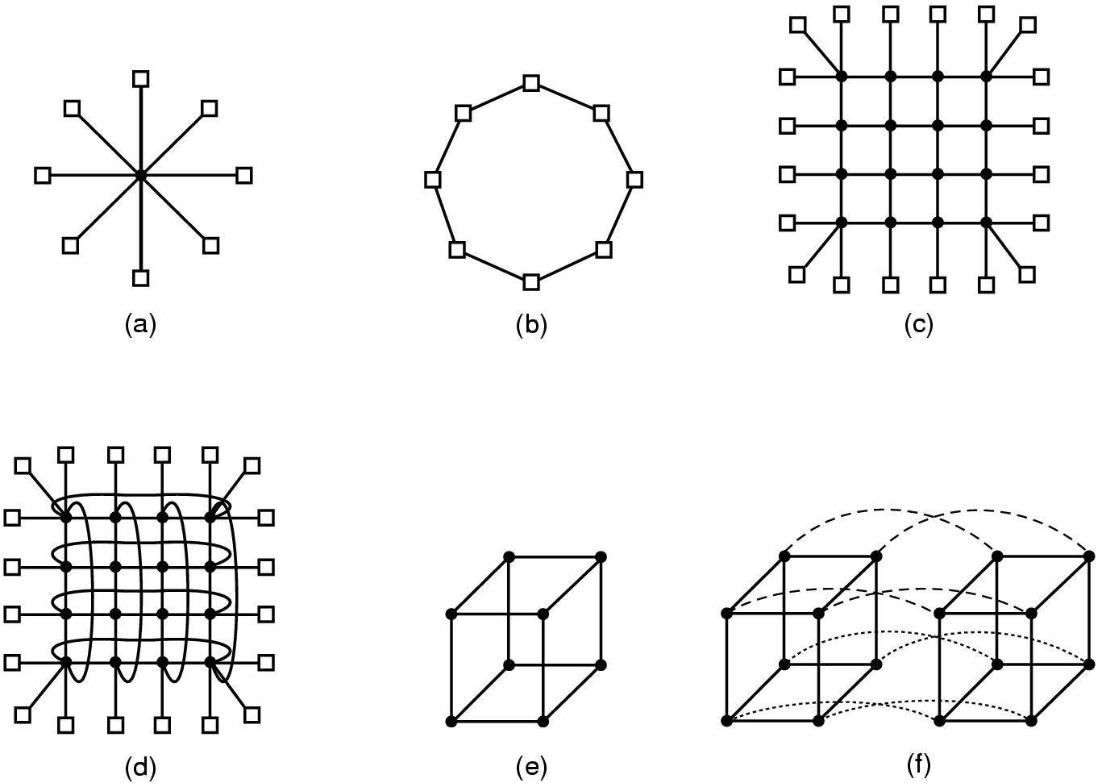
Multicomputer Hardware (1)
Interconnection topologies
  (a) single switch (b) ring (c) grid
  (d) double torus (e) cube (f) hypercube

Slide 26
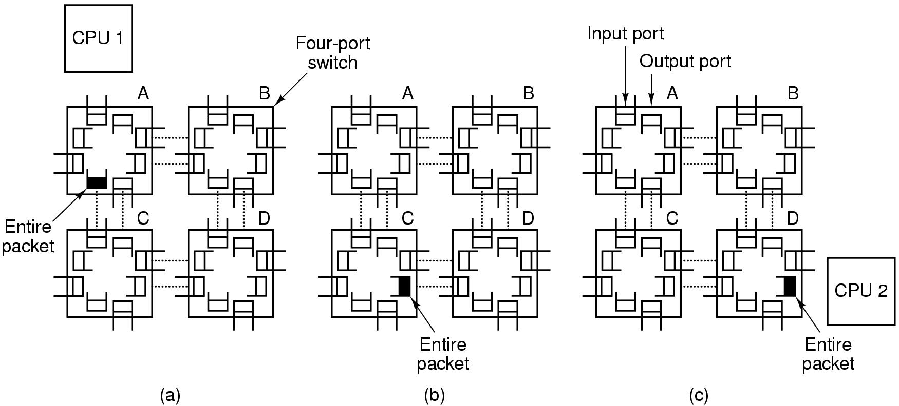
Multicomputer Hardware (2)
Switching scheme
  store-and-forward packet switching

Slide 27
Multicomputer Hardware (3)
Switching schema（其他交换机制）
  circuit switching（电路交换）
    Consists of the first switch first establishing a path through all the switches to the destination switch.
    Once that path has been set up, the bits are pumped all the way from the source to the destination nonstop.
    There is no intermediate buffering at the intervening switches.
  wormhole routing（虫孔路由）
    Breaks each packet up into subpackets and allows the first subpacket to start flowing even before the full path has been built.

Slide 28
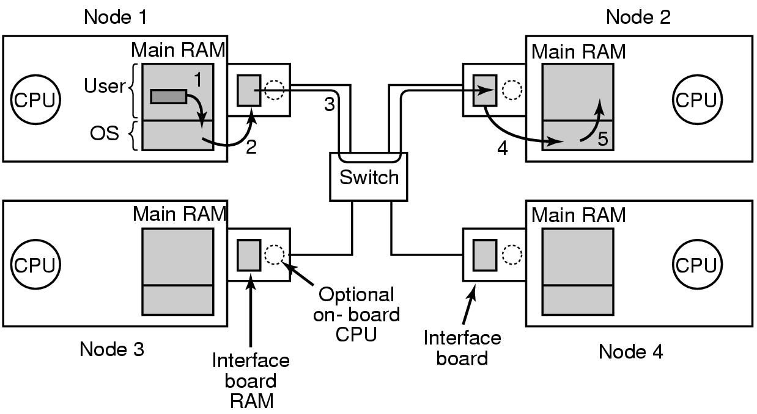
Low-Level Communication Software (1)
Network interface boards in a multicomputer

Slide 29
Low-Level Communication Software (2)
If several processes running on node
  need network access to send packets …
Map interface board to all process that need it
If kernel needs access to network …
Use two network boards
  one to user space, one to kernel

Slide 30
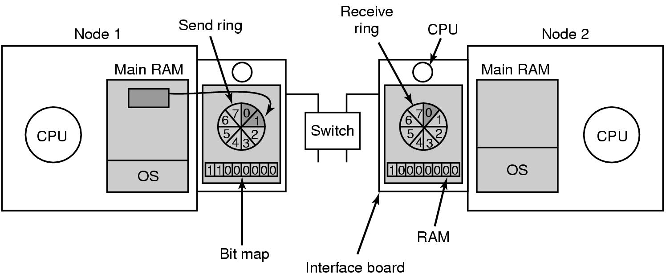
Low-Level Communication Software (3)
Node to Network Interface Communication
Use send & receive rings
coordinates main CPU with on-board CPU

Slide 31
User Level Communication Software
Send and Receive
The communication services provided can be reduced to two calls, one for sending messages and one for receiving them.
  Send(dest, &mptr);
  Receiver(addr, &mptr)

Slide 32
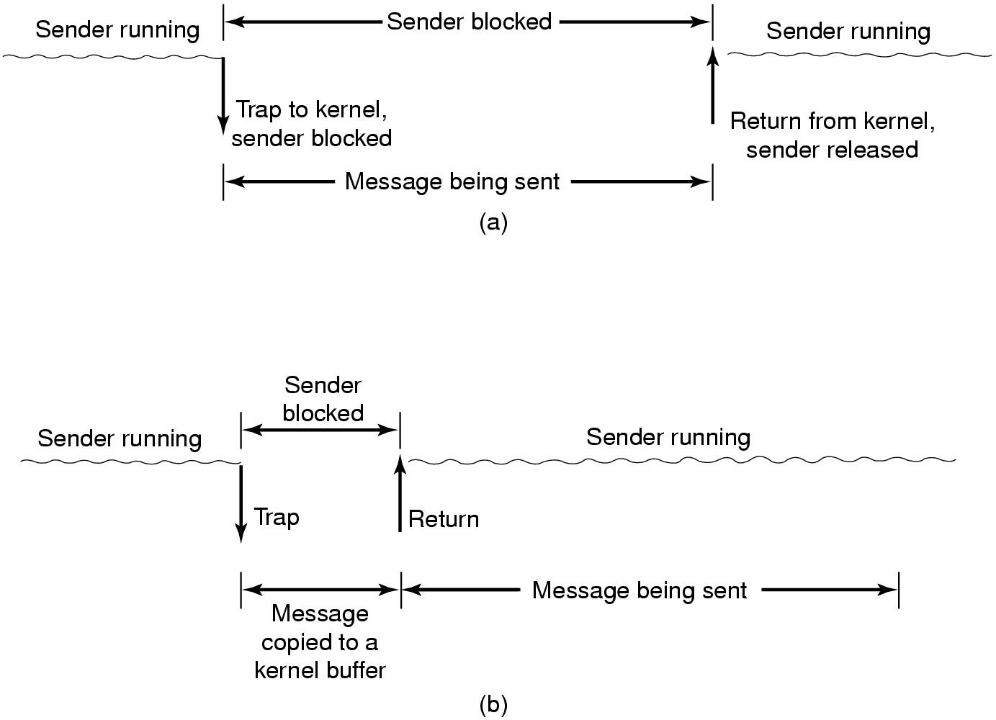
User Level Communication Software
These are blocking
(synchronous) calls
(a) Blocking send call
(b) Nonblocking send call

Slide 33
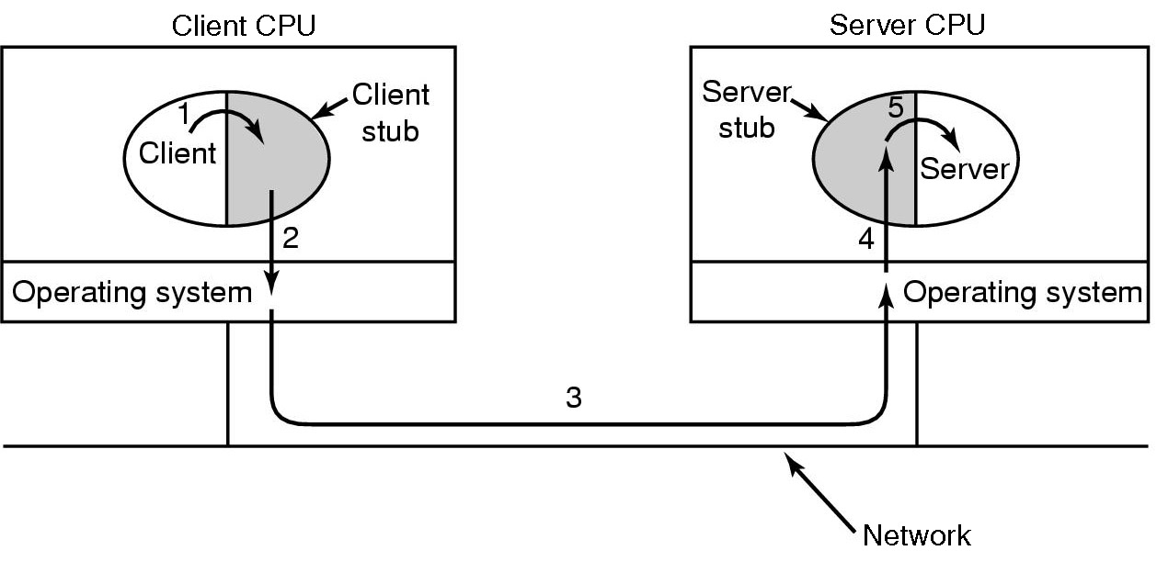
Remote Procedure Call
Steps in making a remote procedure call
  the stubs (存根) are shaded gray

Slide 34
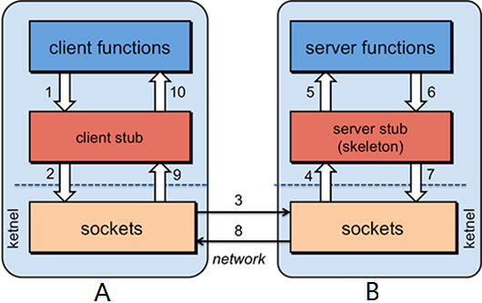
RPC
根据计算能力的需要，可能需要在多台刀片服务器上部署应用，即分布式应用部署。
为了在这个分布式计算环境上，给最终用户一个集成的开发环境，让用户感觉是在一台计算机上进行编程一样，底层多台刀片服务器之间需要使用远程过程调用RPC。

Slide 35
RPC
选型 RPC 框架时，主要考虑三个关键方面：传输协议与数据类型（JSON、XML 等），数据的存储、传输效率，服务器端对数据的请求方式。常见的 RPC 方案有：
SOAP （基于 XML 技术，传输数据过多）
CORBA （过度设计，过于重量级）
DCOM（ 只能用于 Windows 客户端）

Slide 36
RPC
Google 开源的Protocol Buffers ( https://developers.google.com/protocol-buffers )
Facebook 开源的Apache Thrift（https://thrift.apache.org/ ）
Apache Avro( https://avro.apache.org/ ) 等轻量级 RPC 方案。
上面这些序列化框架共同的特点的是：有接口描述（IDL）、性能较高、版本控制和基于二进制的数据传输，同时这些技术都支持包括 C++在内的多种主流语言，并且都是可以部署在 Linux 系统上，定义接口之后预编译生成stub函数以供调用。

Slide 37
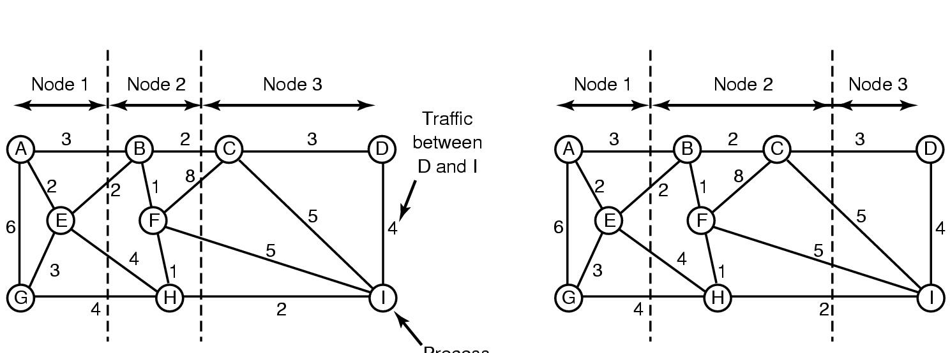
Multicomputer Scheduling
Load Balancing (1)
Process
Graph-theoretic deterministic algorithm
  The total network traffic for (a) is 30 units;
  The total network traffic for (a) is 28 units

Slide 38
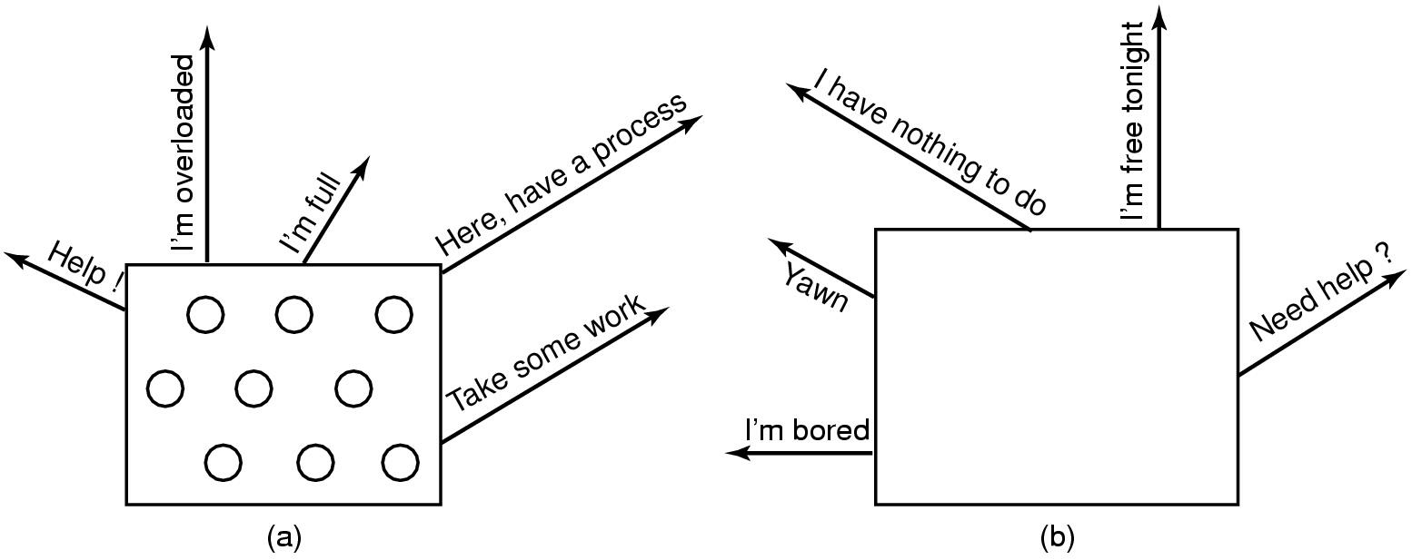
Load Balancing (2)
Sender-initiated distributed heuristic algorithm
  overloaded sender

Slide 39
Load Balancing (3)
Receiver-initiated distributed heuristic algorithm
  under loaded receiver

Slide 40
Chapter 8: Multiple Processor Systems
  8.1 Multiprocessors
  8.2 Multicomputers
  8.3 Virtualization
  8.4 Distributed systems

Slide 41
Virtualization
Virtual machine technology, often just called virtualization（虚拟化）.
This technology allows a single computer to host multiple virtual machines, each potentially running a different operating system.

Slide 42
Virtualization
Advantage:
  a failure in one virtual machine dose not automatically bring down any others.
  having fewer physical machines saves money on hardware and takes up less space
  checkpointing and migrating virtual machines is much easier than normal
  run legacy applications on operating systems no longer supported or which do not work on current hardware
  software development, make sure software works on different OS.

Slide 43
Virtualization
Hypervisor, also called Virtual Machine Monitor (VMM, 虚拟机监视器).
在硬件层之上，独立于操作系统的一层软件。创建虚拟化平台，OS实例运行在这个平台上，使得硬件可以被多个OS和应用共享.

Slide 44
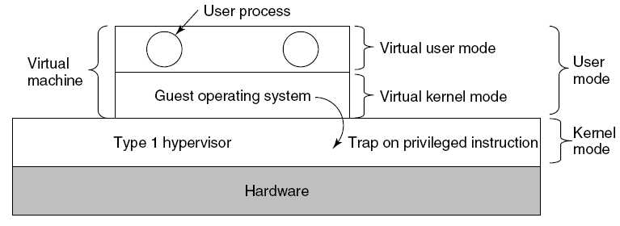
Virtualization
Type 1 Hypervisor
  The virtual machine runs a guest operating system that thinks it is in kernel mode. (it is really in user mode)
  This is called virtual kernel mode.
  Example: Hyper-V, Xen, Vmware vSphere

Slide 45
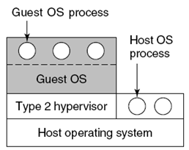
Virtualization
Type 2 Hypervisors
  runs as an ordinary user program on top of a host operating system.
  When it starts for the first time, it will installs the operating system to its virtual disk.
  Example: Vmware worksation, Parallels, VM virtualBox

Slide 46
Virtualization
Paravirtualization（半虚拟化）
  To modify the source code of the guest operating system so that instead of executing sensitive instructions at all, it makes hypervisor calls.
  The hypervisor must define an interface consisting of a set of procedure calls that guest operating systems can use (API).
  A guest operating system from which (some) sensitive instructions have been intentionally removed is said to be paravirtualized.

Slide 47
Virtualization
Type 1 divide into two types: true virtualization and paravirtualization
true virtualization
CPU 指令必须执行在Ring 0 底下， VMware 使用Binary Translation方式让虚拟化能够执行在X86的系统上。将原本要执行不能虚拟化的指令，转换语法，然后再交由VMM去执行。
  如：Vmware vSphere, Microsoft virtual server

Slide 48
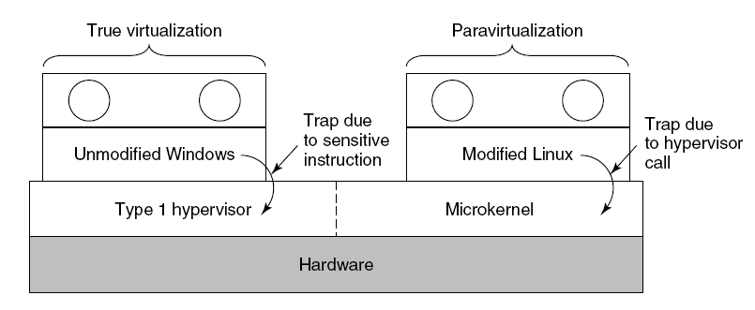
Virtualization
paravirtualization
修改虚拟化作业系统(GuestOS)的核心,让虚拟的作业系统可以直接将不能虚拟化的指令自动转换成 VMM可以执行的指令(hypercall),再由VMM去向硬件提出请求（Windows平台不能用）。
如：Xen, KVM, HyperV

Slide 49
Virtualization
Problems of paravirtualization
  If the sensitive instructions are replaced with calls to the hypervisor, how can the operating system run on the native hardware?
  What if there are multiple hypervisors available in the marketplace?
Solution
  The kernel is modified to call special procedures whenever it needs to do something sensitive.
  Together these procedures, called the VMI(Virtual Machine Interface) form a low-level layer that interfaces with the hardware and hypervisor.

Slide 50
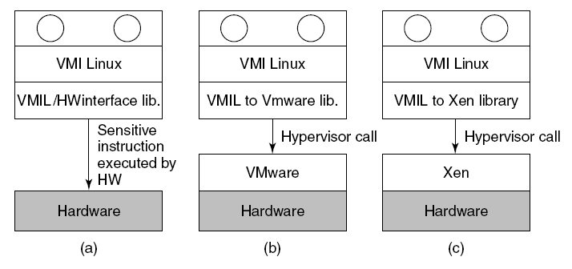
Virtualization
Example of VMI: VMI Linux(VMIL)
VMI Linux running on (a) the bare hardware (b) Vmware (c) Xen

Slide 51
Chapter 8: Multiple Processor Systems
  8.1 Multiprocessors
  8.2 Multicomputers
  8.3 Virtualization
  8.4 Distributed systems

Slide 52
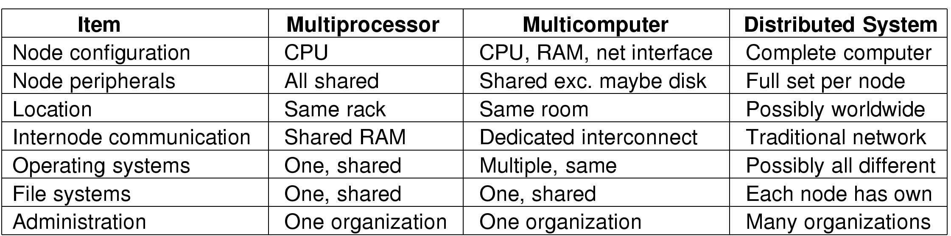
Distributed Systems (1)
Comparison of three kinds of multiple CPU systems

Slide 53
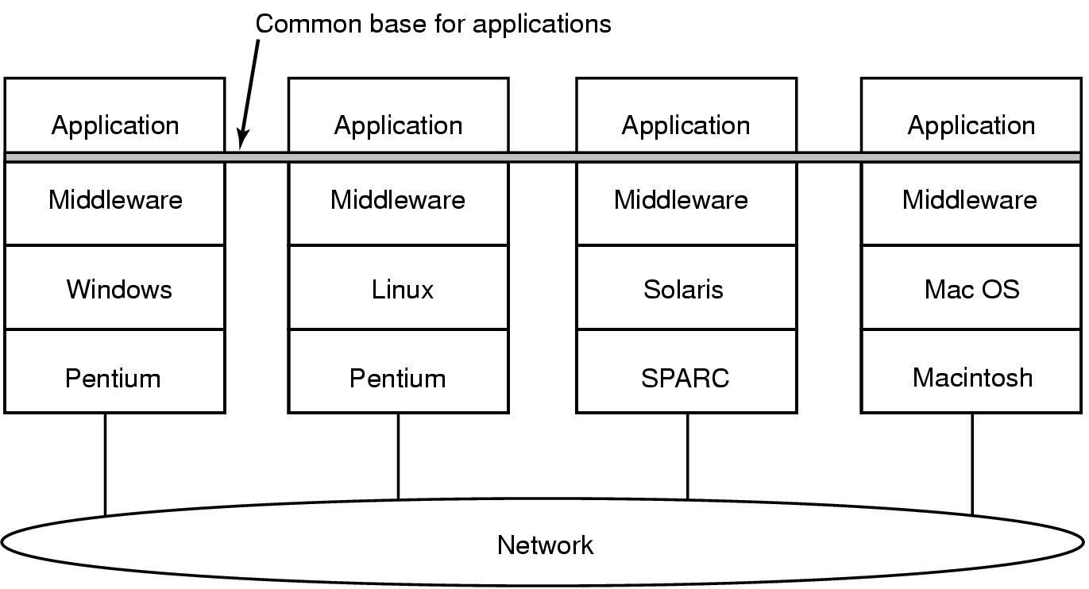
Distributed Systems (2)
Achieving uniformity with middleware

Slide 54
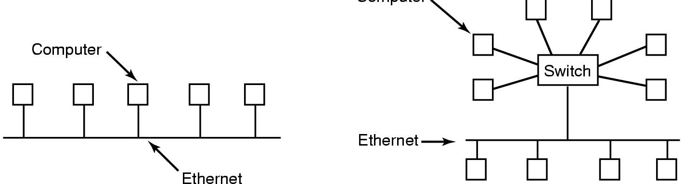
Network Hardware (1)
Computer
(a)
(b)
Ethernet
  (a) classic Ethernet
  (b) switched Ethernet

Slide 55
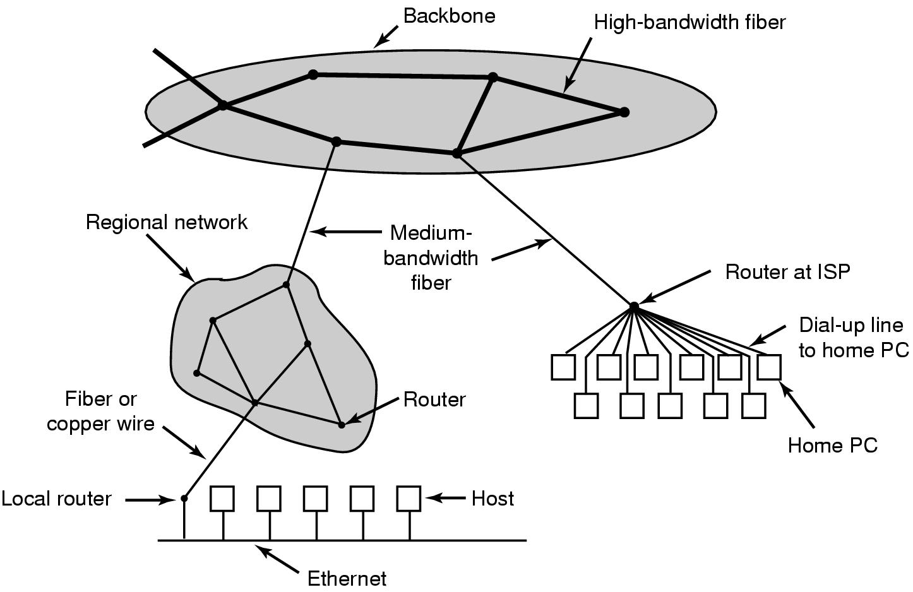
Network Hardware (2)
The Internet

Slide 56
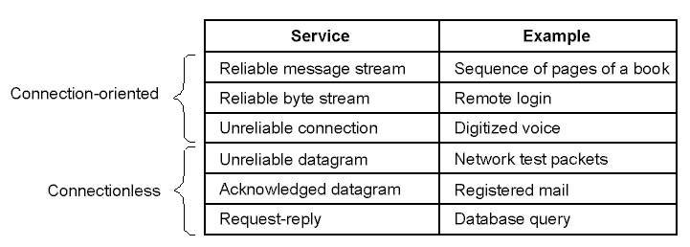
Network Services and Protocols (1)
Network Services

Slide 57
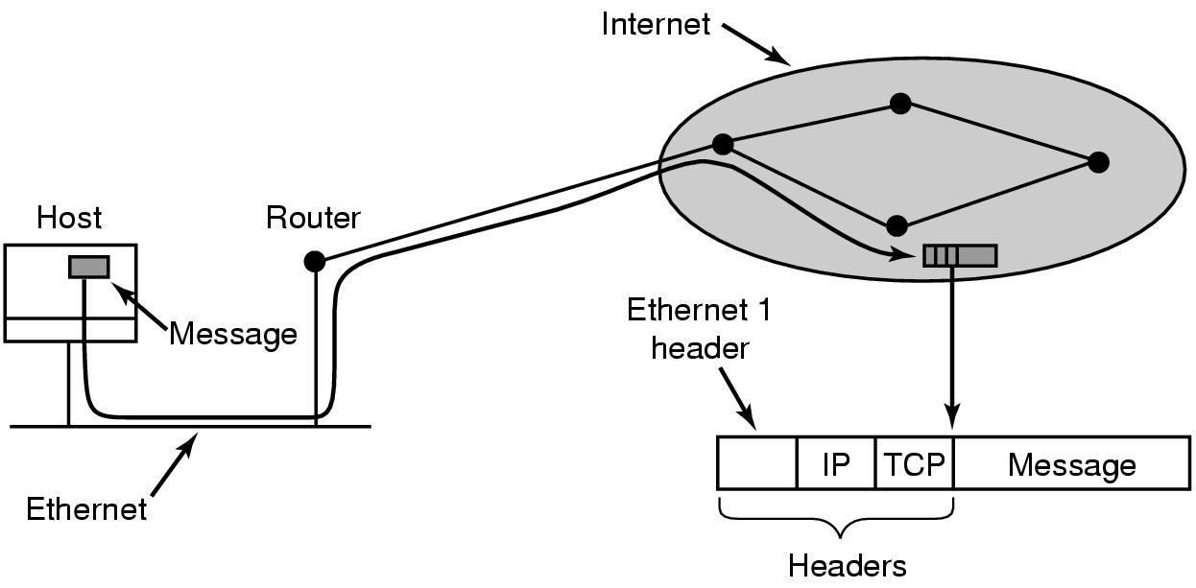
Network Services and Protocols (2)
Accumulation (累加) of packet headers
Internet Protocol
Transmission Control Protocol

Slide 58
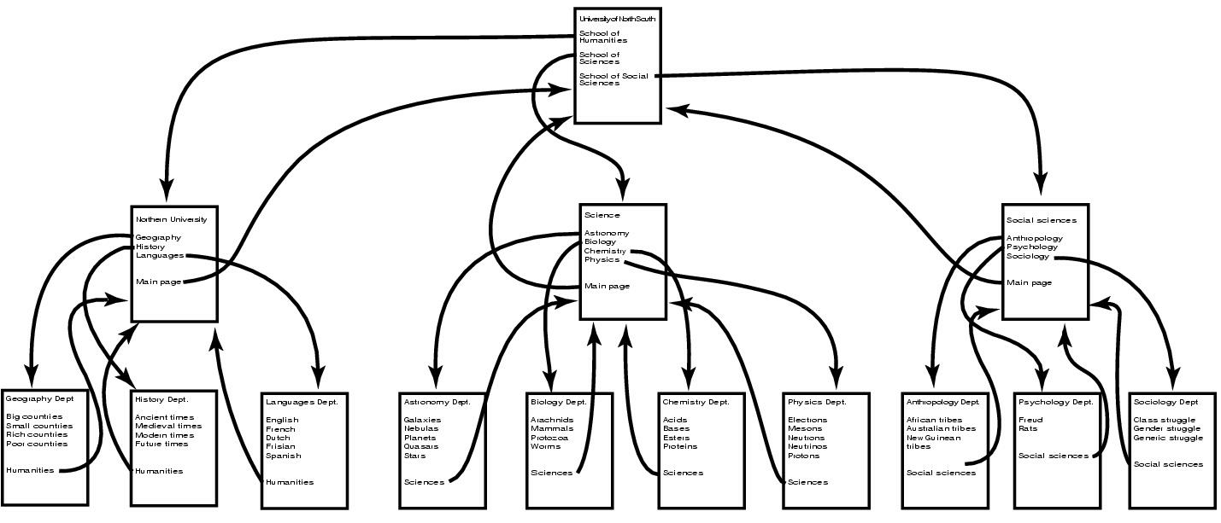
Document-Based Middleware (1)
The Web
  a big directed graph of documents
  URL: Uniform Resource Locator
  HTTP: HyperText Transfer Protocol

Slide 59
Document-Based Middleware (2)
How the browser gets a page
Asks DNS for IP address of a web
DNS replies with IP address
Browser makes connection
Sends request for specified page
Server sends file
TCP connection released
Browser displays text
Browser fetches, displays images

Slide 60
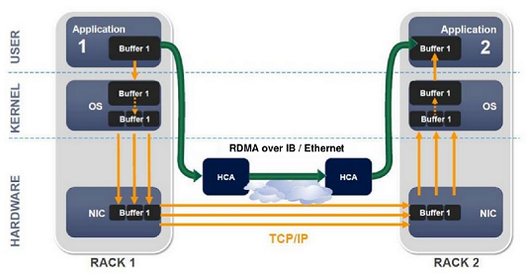
RDMA
分布式计算环境下，多节点之间进行数据交换，相应的数据必须在应用缓冲、核心缓冲和网卡之间进行多次拷贝，这是导致系统传输效率低的主要原因。
RDMA（Remote Direct Memory Access）远程直接内存访问的机制，不需要CPU参与，使得本地应用能够直接将数据放置到远程主机内存中的零拷贝通信能力，可以极大改善网络传输中服务器端数据处理的延迟。

Slide 61
RDMA
RDMA 的工作过程如下：
(1)当一个应用执行RDMA 读或写请求时，不执行任何数据复制.在不需要任何内核内存参与的条件下， RDMA 请求从运行在用户空间中的应用中发送到本地NIC( 网卡)。
(2) NIC 读取缓冲的内容，并通过网络传送到远程NIC。
(3) 在网络上传输的RDMA 信息包含目标虚拟地址、内存钥匙和数据本身.请求完成既可以完全在用户空间中处理(通过轮询用户级完成排列) ，或者在应用一直睡眠到请求完成时的情况下通过内核内存处理.RDMA 操作使应用可以从一个远程应用的内存中读数据或向这个内存写数据。
(4) 目标NIC 确认内存钥匙，直接将数据写人应用缓存中.用于操作的远程虚拟内存地址包含在RDMA 信息中。

Slide 62
RDMA
基于Infiniband或10GbE/40GbE以太网的多处理器板间高速数据传输协议，面向高实时性要求，采用RDMA on InfiniBand或ROCE(RDMA over Converged Ethernet)实现多处理器板间的高速数据传输，在协议实现中不再调用低效的UDP等协议，而是直接调用符合开放网络联盟( OpenFabrics Alliance) 的 “Verbs” API接口。

